Slide 1


DNA Sequence Analysis Tool Using
Advanced String-Matching Algorithms
DSA-III Mini Project
Project Report submitted for the partial fulfilment of grade for the course
Data Structures and Algorithms – 3 (DSA-III) | A.Y. 2026-2027
Submitted by
S. Yuva Mahesh (2520030336) • K. Shloka (2520030334) • Sreshta (2520030217)
Team Number: 6 | Section: 5
Under the guidance of
MS D SWATHI
Assistant Professor, CSE
KLH University, Bachupally Campus — Hyderabad-500090, Telangana, India

Slide 2
Contents
6. Results
7. Hardware and Software Requirements
8. Conclusion
9. Future Scope
1. Abstract
2. Introduction
3. Literature Survey
Problem Statement and Objectives
5. Flow Chart

Slide 3
a
Abstract
Java-based web application (DSA-III mini-project) for DNA motif searching and performance analysis.
Implements four string-matching algorithms: KMP, Z-Algorithm, Rabin-Karp, and Aho-Corasick.
KMP, Z-Algorithm and Rabin-Karp search one motif at a time; Aho-Corasick searches many motifs simultaneously.
Processes DNA sequences built from four nucleotide bases: A, T, G, C.
Users paste a sequence or upload a .txt/.fasta file, then search for one or more motifs.
Identifies match positions, highlights matches, times each algorithm, and reports the fastest one.
Runs entirely in memory - no database required.

Slide 4
Introduction
DNA is a sequence built from just four letters: A (Adenine), T (Thymine), G (Guanine), C (Cytosine).
A recurring short sequence within DNA - like a start codon or a promoter region - is called a motif.
Finding every occurrence of a motif inside a long genome is a classic string-matching problem.
A naive character-by-character search takes O(n·m) time - too slow for large genome files.
Advanced algorithms (KMP, Z-Algorithm, Rabin-Karp, Aho-Corasick) solve this in linear or near-linear time.
This project builds a practical tool that applies all four algorithms to real DNA-style data and compares them head-to-head.

Slide 5
Literature Survey
Algorithm | Origin | Core Idea
Knuth-Morris-Pratt (KMP) | Knuth, Morris & Pratt (1977) | Failure function (LPS array) avoids re-checking matched characters.
Z-Algorithm | Gusfield, Algorithms on Strings, Trees and Sequences (1997) | Z-array gives the longest match with the prefix at every position.
Rabin-Karp | Rabin & Karp (1987) | Polynomial rolling hash compares windows in O(1) before a direct check.
Aho-Corasick | Aho & Corasick (1975) | Trie of all patterns plus KMP-style failure links; finds every pattern in one pass.

Slide 6
Problem Statement and Objectives
Problem Statement :
Searching for specific DNA motifs within large genome sequences using naive character-by-character comparison can require O(n·m) time for each search, making repeated searches computationally expensive as the sequence size grows. This project addresses this challenge by applying advanced string-matching algorithms to efficiently perform single-pattern and multi-pattern searches, accurately identify motif locations, and compare algorithm performance on DNA sequence data.
Objectives :
The main objective of the project is to accurately locate DNA motif patterns within sequence data using advanced string-matching techniques. The system also aims to support simultaneous searching of multiple motifs using the Aho-Corasick algorithm, while measuring and comparing actual execution times with the theoretical time and space complexity of each algorithm. It validates DNA input according to the nucleotide alphabet {A, T, G, C} and is designed to operate entirely offline without a database or external services.

Slide 7
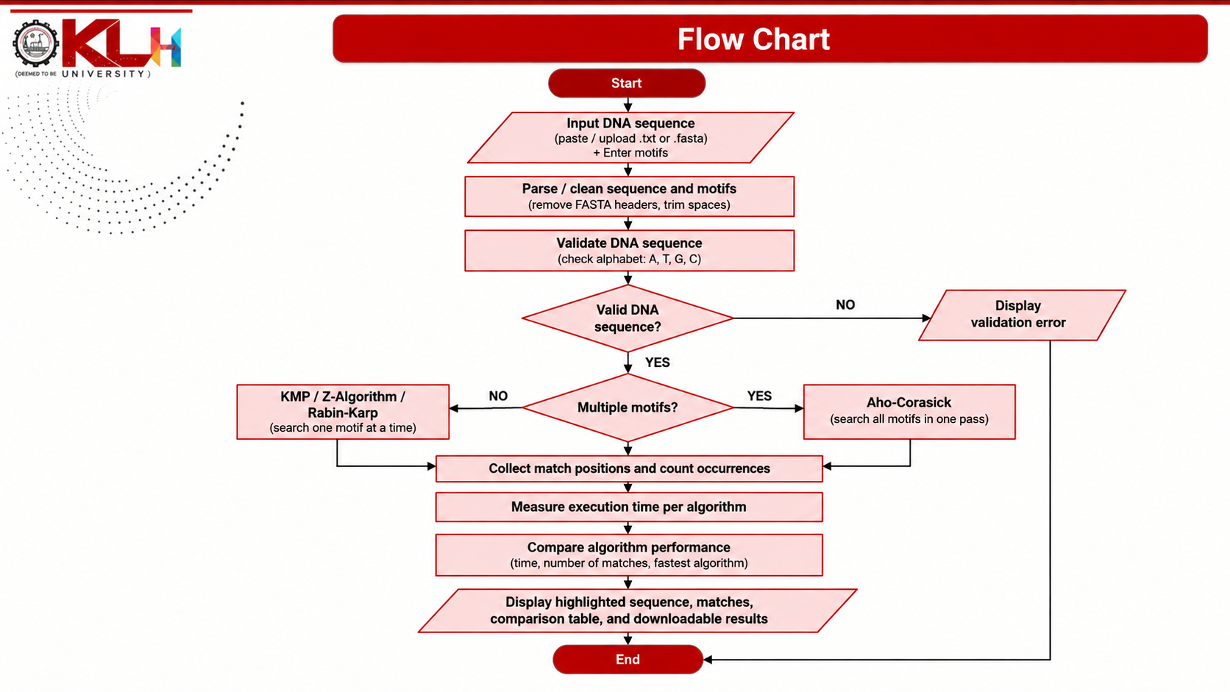
-----------

Slide 8
Results
Sample run: sequence length 118 bases, motifs = {ATG, TAGC, GTAC, ATGC}
Algorithm | Occurrences | Time (ms) | Time Complexity
KMP | 26 | 2.5341 | O(n + m)
Z-Algorithm | 26 | 1.2021 | O(n + m)
Rabin-Karp ★ Fastest | 26 | 0.6217 | O(n + m) avg
Aho-Corasick | 26 | 2.5820 | O(n + m + z)
All four algorithms agree exactly on the number and position of every match, confirming correctness.
Rabin-Karp was fastest in this run; results vary by input size and motif count.
The application highlights every match directly within the sequence and lets the user download the full report.

Slide 9
Hardware and Software requirements
Hardware
Software
Any standard desktop or laptop (Windows / macOS / Linux)
Minimum 4 GB RAM recommended
No GPU or special hardware required
Java Development Kit (JDK) 17 or later
Any modern web browser (Chrome, Edge, Firefox)
No Maven, no Spring Boot, no database, no internet required to run

Slide 10
Conclusion
The DNA Sequence Analysis Tool successfully demonstrates the practical application of four advanced string-matching algorithms—KMP, Z-Algorithm, Rabin-Karp, and Aho-Corasick—for accurate DNA motif searching. KMP, Z-Algorithm, and Rabin-Karp efficiently handle single-motif searches, while Aho-Corasick supports multiple motifs in a single traversal of the sequence. The system provides accurate match locations and performance measurements, enabling meaningful comparison of the implemented algorithms. It processes DNA-style data using the nucleotide bases A, T, G, and C and operates locally without requiring a database or external services, making it a lightweight and effective platform for demonstrating advanced DSA concepts in bioinformatics and genome sequence analysis.

Slide 11
Future Scope
The future scope of the project includes extending the tool with fuzzy motif matching using Edit Distance and Smith-Waterman alignment, reverse-complement searching for both DNA strands, and suffix array with LCP-based analysis for identifying similar or repeated regions across genome files. The system can also be enhanced through parallel processing of chromosome-sized sequences to improve performance on very large datasets, along with persistent search history for cross-session analysis. Additional improvements could include interactive visualizations for motif distribution and algorithm performance, better memory optimization, and support for genome datasets of 100 MB or larger, making the tool more scalable and useful for practical bioinformatics applications.

Slide 12
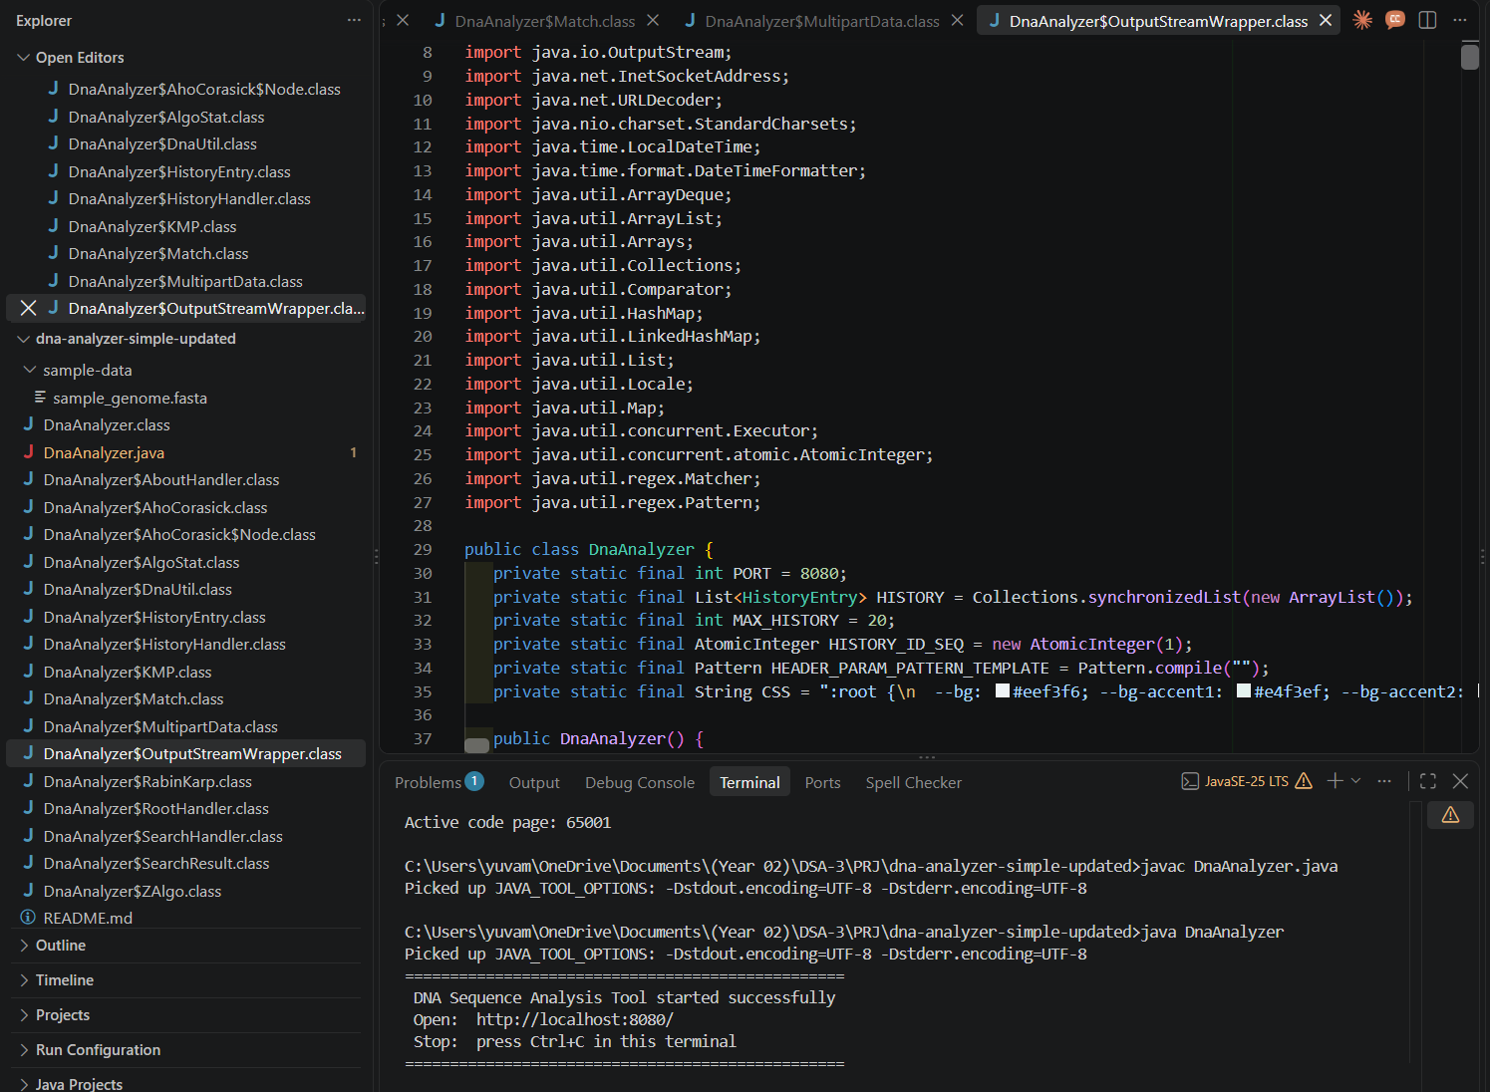
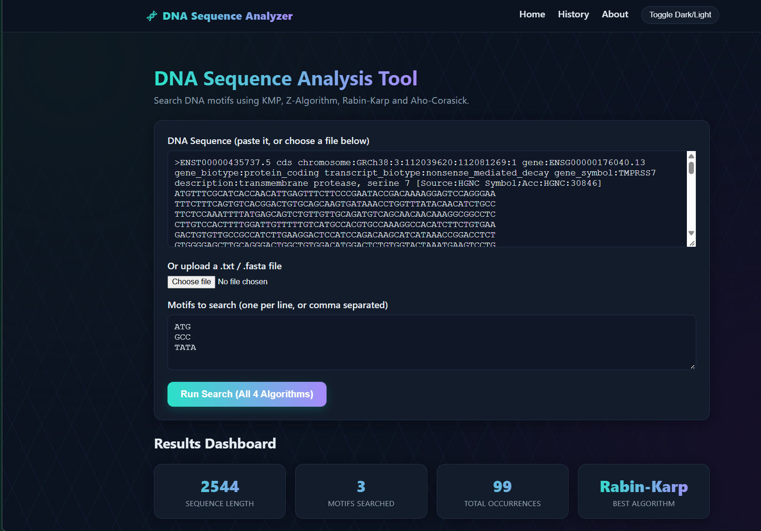
INPUT & OUTPUT

Slide 13
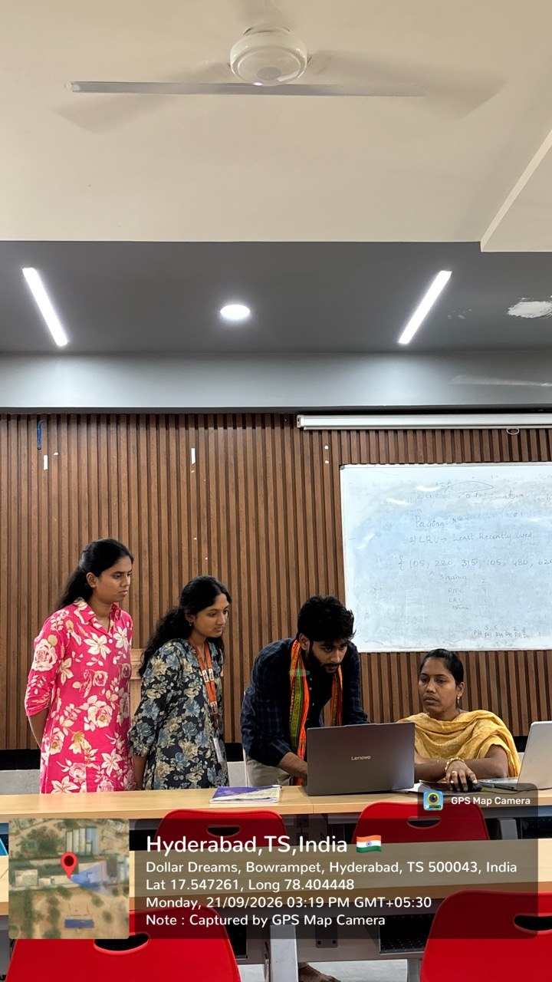
-----------

Slide 14
Thank you
DNA Sequence Analysis Tool Using Advanced String-Matching Algorithms | Team 6

